Slide 1
SQL CONSTRAINTS
Constraints are used to limit the type of data that can go into a table.
Constraints prevent deletion of a table if there are dependencies.
Constraints can be specified when a table is created (with the CREATE TABLE statement) or after the table is created (with the ALTER TABLE statement).

Slide 2
The following constraint types are valid :
NOT NULL
UNIQUE
PRIMARY KEY
FOREIGN KEY
CHECK
DEFAULT

Slide 3
Example without any constraints :
CREATE TABLE Persons ( P_Id int, LastName varchar(255), FirstName varchar(255), Address varchar(255), City varchar(255) )
The elements are now inserted using a INSERT INTO statement.

Slide 4
SQL NOT NULL Constraint
The NOT NULL constraint enforces a column to NOT accept NULL values.
The NOT NULL constraint enforces a field to always contain a value. This means that you cannot insert a new record, or update a record without adding a value to this field.

Slide 5
Example using NOT NULL :
CREATE TABLE Persons ( P_Id int NOT NULL, LastName varchar(255) NOT NULL, FirstName varchar(255), Address varchar(255), City varchar(255) )
Now run insert query without lastname

Slide 6
SQL UNIQUE Constraint
The UNIQUE constraint uniquely identifies each record in a database table.
The UNIQUE and PRIMARY KEY constraints both provide a guarantee for uniqueness for a column or set of columns.
A PRIMARY KEY constraint automatically has a UNIQUE constraint defined on it.
Note that you can have many UNIQUE constraints per table, but only one PRIMARY KEY constraint per table.

Slide 7
Example using UNIQUE :
CREATE TABLE Persons ( P_Id int NOT NULL UNIQUE, LastName varchar(255) NOT NULL, FirstName varchar(255), Address varchar(255), City varchar(255) )

Slide 8
CREATE TABLE Persons ( P_Id int NOT NULL, LastName varchar(255) NOT NULL, FirstName varchar(255), Address varchar(255), City varchar(255), UNIQUE (P_Id) )

Slide 9
CREATE TABLE Persons ( P_Id int NOT NULL, LastName varchar(255) NOT NULL, FirstName varchar(255), Address varchar(255), City varchar(255), CONSTRAINT uc_PersonID UNIQUE (P_Id,LastName) )

Slide 10
ALTER TABLE Persons ADD UNIQUE (P_id)
ALTER TABLE Persons ADD CONSTRAINT uc_PersonID UNIQUE (P_id, LastName)
ALTER TABLE Persons DROP CONSTRAINT uc_PersonID

Slide 11
PRIMARY KEY
The PRIMARY KEY constraint uniquely identifies each record in a database table.
Primary keys must contain unique values.
A primary key column cannot contain NULL values.
Each table should have a primary key, and each table can have only ONE primary key.

Slide 12
Example:
CREATE TABLE Persons ( P_Id int NOT NULL, LastName varchar(255) NOT NULL, FirstName varchar(255), Address varchar(255), City varchar(255), PRIMARY KEY (P_Id) )

Slide 13
CREATE TABLE Persons ( P_Id int NOT NULL PRIMARY KEY, LastName varchar(255) NOT NULL, FirstName varchar(255), Address varchar(255), City varchar(255) )

Slide 14
CREATE TABLE Persons ( P_Id int NOT NULL, LastName varchar(255) NOT NULL, FirstName varchar(255), Address varchar(255), City varchar(255), CONSTRAINT pk_PersonID PRIMARY KEY (P_Id) )

Slide 15
ALTER TABLE Persons ADD PRIMARY KEY (P_Id)
ALTER TABLE Persons ADD CONSTRAINT pk_PersonID PRIMARY KEY (P_Id,LastName)

Slide 16
ALTER TABLE Persons DROP PRIMARY KEY
ALTER TABLE Persons DROP CONSTRAINT pk_PersonID

Slide 17
SQL FOREIGN KEY Constraint
A FOREIGN KEY in one table points to a PRIMARY KEY in another table.
The FOREIGN KEY constraint is used to prevent actions that would destroy links between tables.
The FOREIGN KEY constraint also prevents that invalid data form being inserted into the foreign key column, because it has to be one of the values contained in the table it points to.

Slide 18
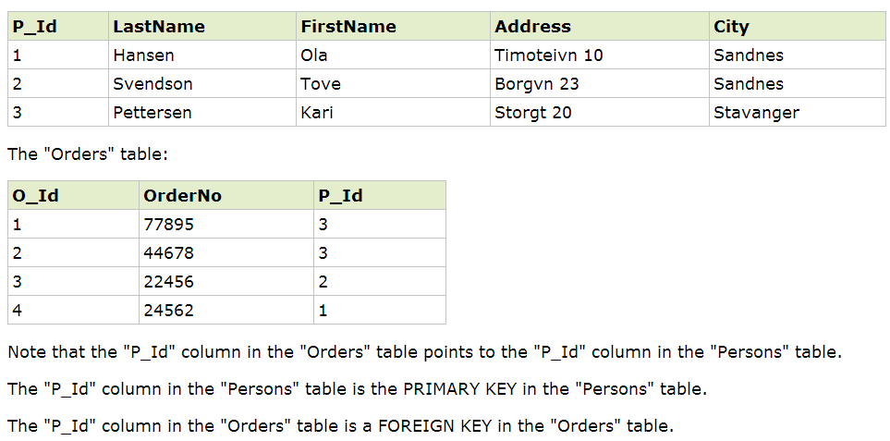

Slide 19
CREATE TABLE Orders ( O_Id int NOT NULL PRIMARY KEY, OrderNo int NOT NULL, P_Id int FOREIGN KEY REFERENCES Persons(P_Id) )

Slide 20
CREATE TABLE Orders ( O_Id int NOT NULL, OrderNo int NOT NULL, P_Id int, PRIMARY KEY (O_Id), FOREIGN KEY (P_Id) REFERENCES Persons(P_Id) )

Slide 21
SQL CHECK Constraint
The CHECK constraint is used to limit the value range that can be placed in a column.
If you define a CHECK constraint on a single column it allows only certain values for this column.
If you define a CHECK constraint on a table it can limit the values in certain columns based on values in other columns in the row.

Slide 22
CREATE TABLE Persons ( P_Id int NOT NULL, LastName varchar(255) NOT NULL, FirstName varchar(255), Address varchar(255), City varchar(255), CHECK (P_Id>0) )

Slide 23
CREATE TABLE Persons ( P_Id int NOT NULL CHECK (P_Id>0), LastName varchar(255) NOT NULL, FirstName varchar(255), Address varchar(255), City varchar(255) )

Slide 24
SQL DEFAULT Constraint
The DEFAULT constraint is used to insert a default value into a column.
The default value will be added to all new records, if no other value is specified.

Slide 25
CREATE TABLE Persons ( P_Id int NOT NULL, LastName varchar(255) NOT NULL, FirstName varchar(255), Address varchar(255), City varchar(255) DEFAULT 'Sandnes' )

Slide 26
CREATE TABLE Orders ( O_Id int NOT NULL, OrderNo int NOT NULL, P_Id int, OrderDate date DEFAULT GETDATE() )

Slide 27
ALTER TABLE Persons ALTER City SET DEFAULT 'SANDNES‘
ALTER TABLE Persons MODIFY City DEFAULT 'SANDNES'

Slide 28
ALTER TABLE Persons ALTER City DROP DEFAULT
ALTER TABLE Persons ALTER COLUMN City DROP DEFAULT

